Slide 1
Introduction
Your Search is ends here, impact of 5G in Telecom.
AS a part of internship, we have to provide insights to
Wavecon revenue and insights related team which could be
consumed by them.
Mainly here focusing on impact of Before and After 5G.

Slide 2
Wavecon
Wavecon is a leading company in Telecom industry, they has to be analyze to detect 5G impact on revenue, KPIs and other matrix from June.
To conduct comparison between before and after 5G 4 month change.
Wavecon operates in different cities to sell their plans :
Mumbai
Delhi
Kolkata
Bangalore
Chennai
Hyderabad
Pune
Ahmedabad
Jaipur
Lucknow
Patna
Coimbatore
Chandigarh
Gurgaon
Raipur

Slide 3
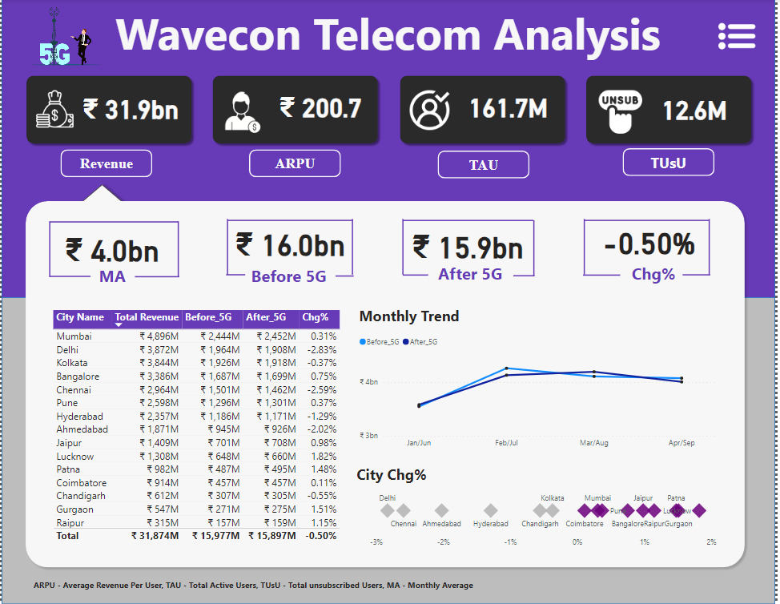
Major Insights :
Revenue
Since 5G launch impact on revenue which is before 5G(16bn) vs after 5G(15.9bn) with the change of - 0.50%. This is temporary little revenue slow down since 5G launch.
Mumbai generates highest total(4.9bn) and After 5G(2.5bn) revenue followed by Delhi, Kolkata and Bangalore.
Lucknow made intensive positive percentage change(1.82%) since 5G launch with the followed by Gurgaon, Patna and Raipur.
Delhi generates lowest percentage change(-2.83%) since 5G launch followed by Chennai and Ahmedabad.(Required to implement strategy move to improve 5G in that tier-1 cities).

Slide 4
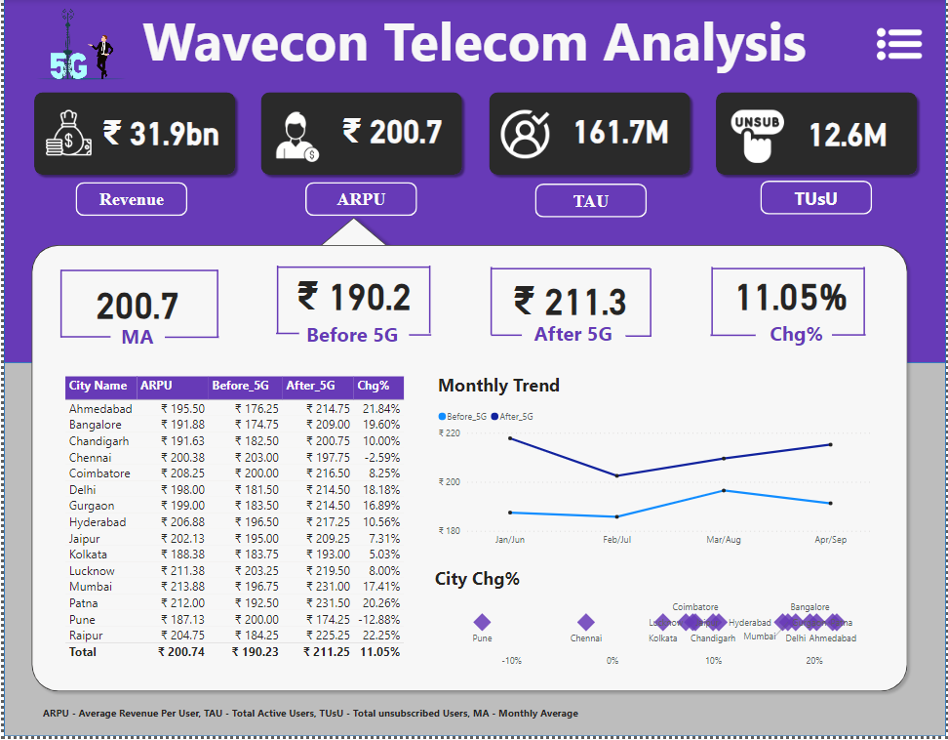
ARPU(Average Revenue Per User )
Since 5G launch, impact on ARPU which is before 5G(₹190) vs after 5G(₹211) with the change of 11.05%.
Raipur gains highest ARPU(22.25%) change with the followed by Ahmedabad and Patna which shows positive impact of from 5G launch.
In Monthly trend After 5G made most ARPU by each month vs Before 5G.

Slide 5
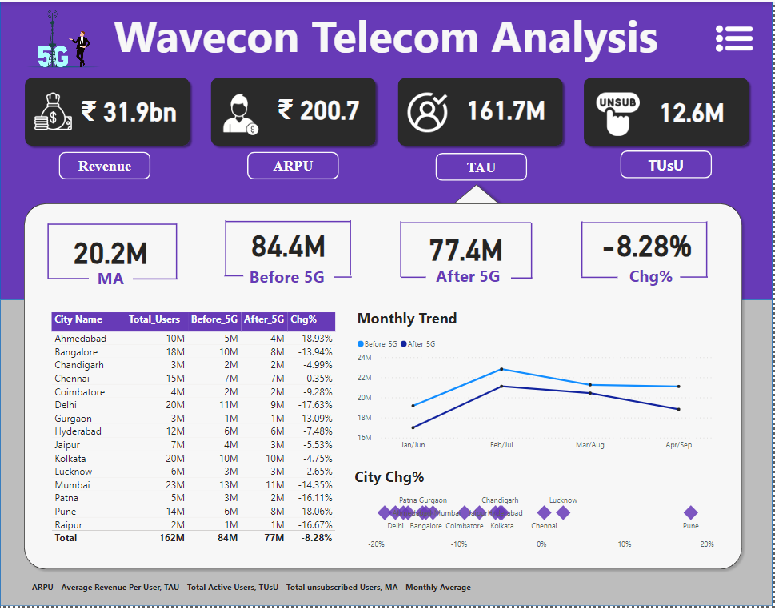
TAU (Total Active Users)
Since 5G launch, TAU(Total Active User) KPIs are showing intensive negative affect with before 5G(84.4M) vs after 5G(77.4M) that’s why 7M with (-8.28%) active user quit since 5G launch.
In the Monthly Trend are showing intensive active users quit, After 5G made lowest TAU by each month vs Before 5G.
Ahmedabad shows lowest TAU %change (-18.93%) –ve impact of 5G followed by Delhi, Raipur and Patna.
But, Pune gains most active user change (18.06%) and far behind followed city is Lucknow(2.65%).

Slide 6
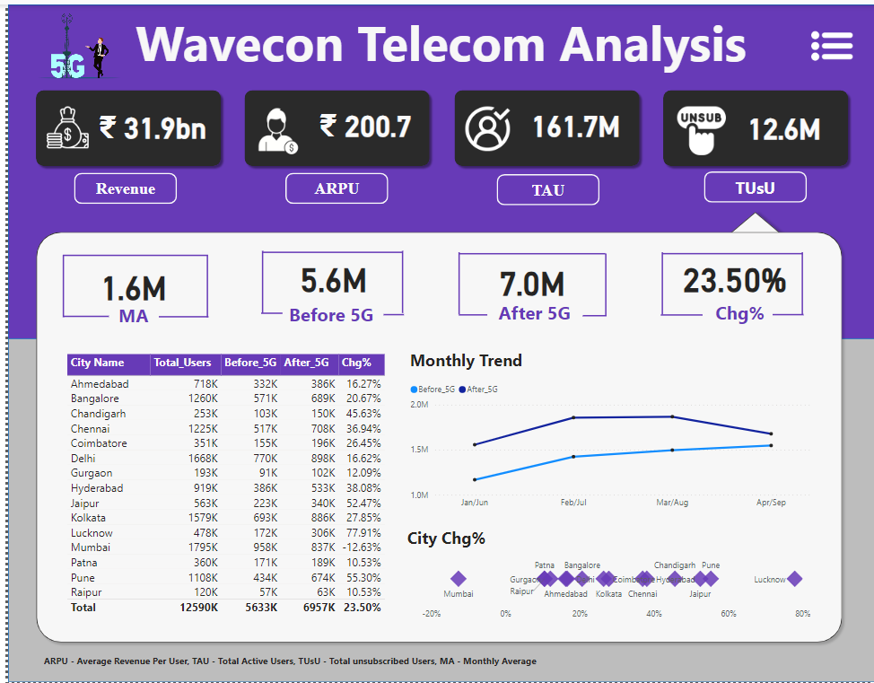
TUsU (Total Unsubscribed Users)
Since 5G launch, negative impact on before 5G(5.6M) vs after 5G(7M) that means 1.4M unsubscribed users extend with (-23.50%).
In the monthly trend after 5G unsubscribed users grown in each month vs Before 5G.
Lacknow is most unsubscribed users -77.91% change, followed by pune (-55.30%), Jaipur and Chandigarh.

Slide 7
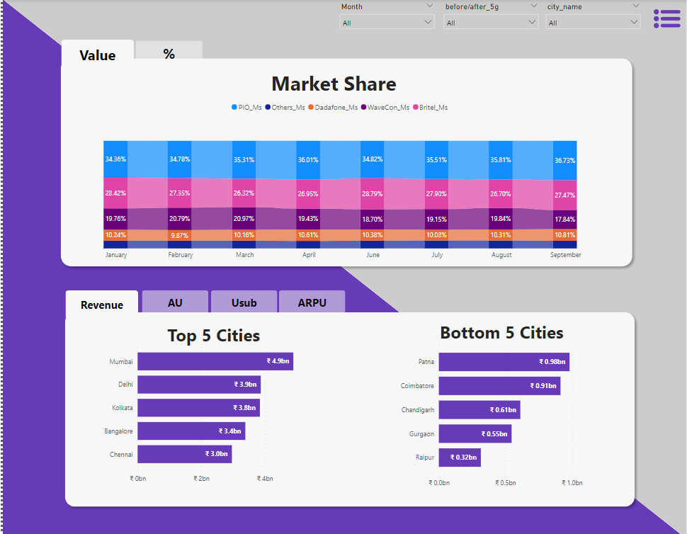
Market Share
Since 5G launch, market share of Wavecon is steadily fluctuate between (17% -19.50%) and before 5G (19% - 21%) with the 3rd rank, little bit -ve impact on market share.
Top 5 cities (Mumbai, Delhi, Kolkata, Bangalore and Chennai) dominets 59.74% market share of the total revenue from 5G launch in Wavecon.

Slide 8
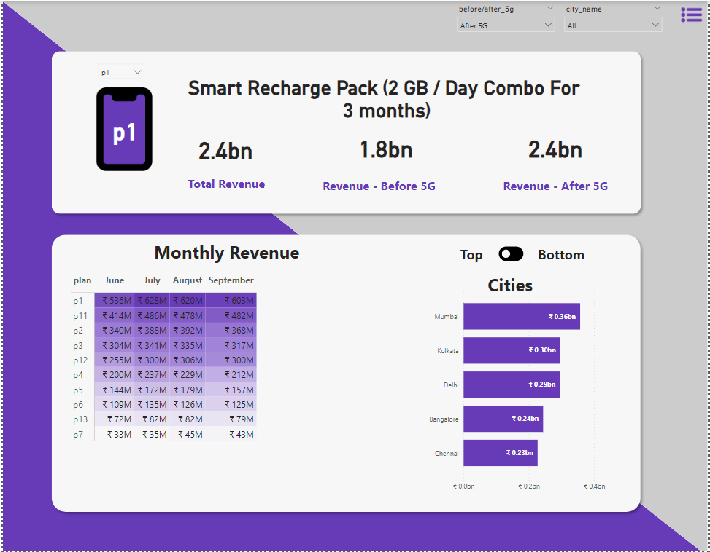
Plans
Since 5G launch, plan p1 is performing well with 2.4bn revenue, followed by plan p11, p2 and p3, (This top 4 plans dominant 52% of the total all plans revenue). Whereas plan p7 is not performing with 155.6M revenue, with follows of p13 (314.5M), p6 (494.6M).
The Plan p7 (155.6M) and p13 (314.5M) is affected largely with revenue by 5G launch.
we should discontinue this p7 & p13 with the help of previous Wavecon strategy, which is the bottom 3 plans have been discontinue Before 5G (it’s generates low revenue).
But, plan p7 & p11 generated revenue from tier-1 cities (Bangalore, Delhi, Kolkata and Mumbai).

